Slide 1

Email Spam/Ham Detection
Name: Shubham Khoju Shrestha
London met Id: 23050343
Module code: CU6051NI
Module Name: Artificial Intelligence

Slide 2
Agenda
AI Concept Used
Research Evidence
Reason For Selection of Topic
Solution and Developed Application
Achieved Results
How it solves real problems
Pseudocode
Flowchart
Conclusion

Slide 3
AI Concept Used
Artificial Intelligence and Machine Learning for decision making
Natural Language Processing (NLP) for handling email text data
TF-IDF for converting text into numerical features
Supervised learning for binary classification (Spam and Ham)
Machine Learning models : Naïve Bayes, Logistic Regression and Support Vector Machine (SVM).

Slide 4
Research Evidence
Recent studies show ML-based spam detection remains highly effectively
TF-IDF combined with Linear classifiers performs well on large text datasets
Algorithms like Naïve Bayes, Logistic Regression and SVM are widely used benchmarks

Slide 5
Reason For Selection of Topic
Spam emails are major real-world cybersecurity problem
Manual filtering in inefficient and error-prone
The topic allows practical application of AI, NLP and classification techniques
Availability of a large real-world dataset supports reliable experimentation

Slide 6
Solution and Developed Application
The system processes implements a supervised text classification pipeline using NLP technique
Email subject and message fields are pre-processed through text normalization and noise removal
TF-IDF vectorization is applied to transform textual data into high dimensional feature vectors
Classification is performed using Naïve Bayes, Logistic Regression and linear Support Vector Machine
The trained models are used to classify user-provided email input into spam or ham classes

Slide 7
Achieved Results
All Models achieved high classification performance with accuracy above 98%
SVM demonstrated the highest predictive capability among the evaluated classifiers
Five-fold cross validation confirms model robustness and consistent generalization
Train-test performance comparison showed no evidence of overfitting.

Slide 8
How it solves real problems
Enables automated detection of unsolicited and malicious emails
Helps reduce phishing and spam related security risks
Provides a scalable and efficient solution for large volume email systems.
Supports real time decision making in practical email filtering application

Slide 9
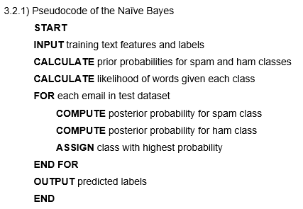
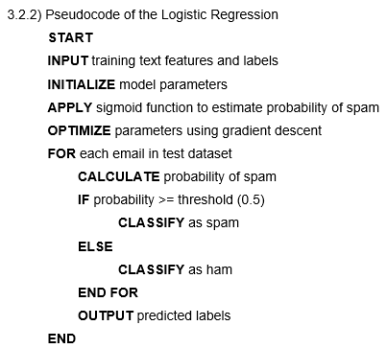
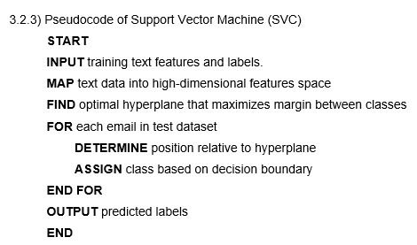
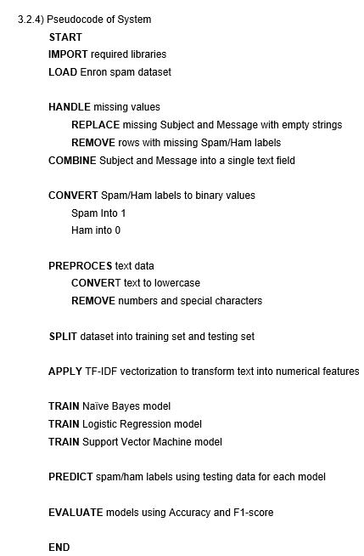
Pseudocode
Naïve Bayes Logistic Regression Support Vector Machine System
(SVM)

Slide 10
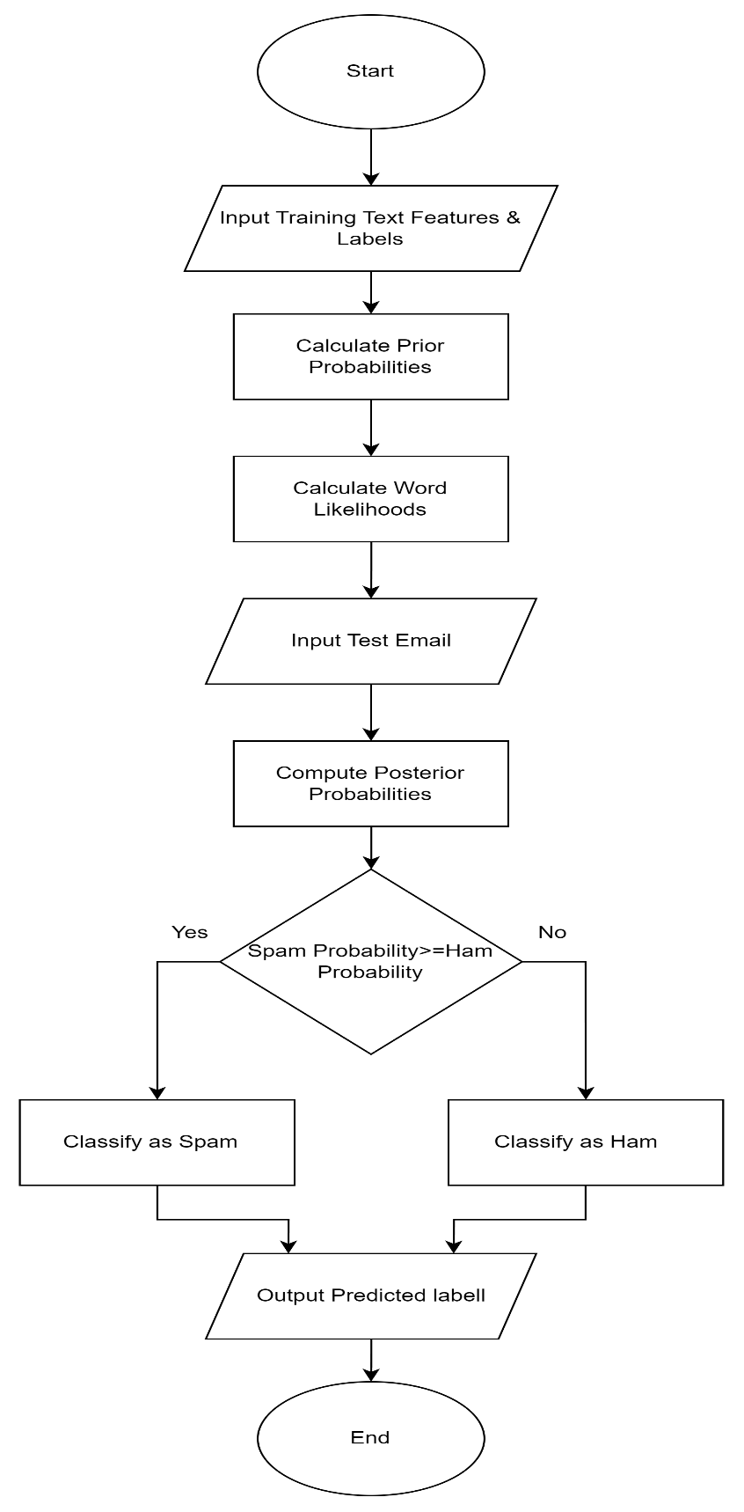
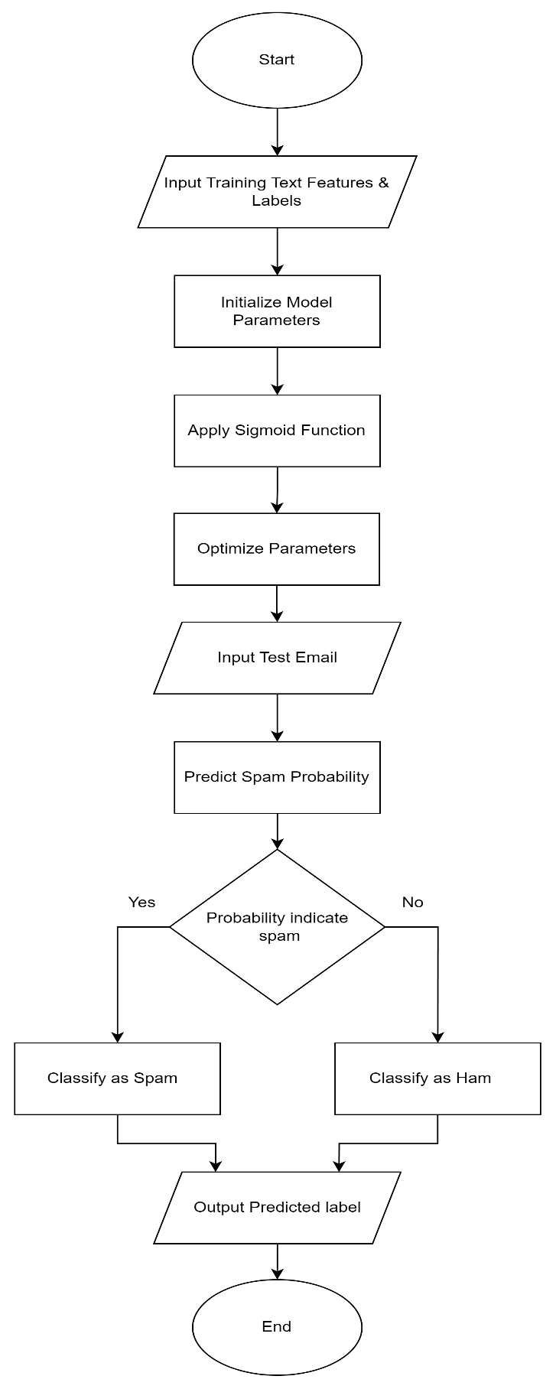
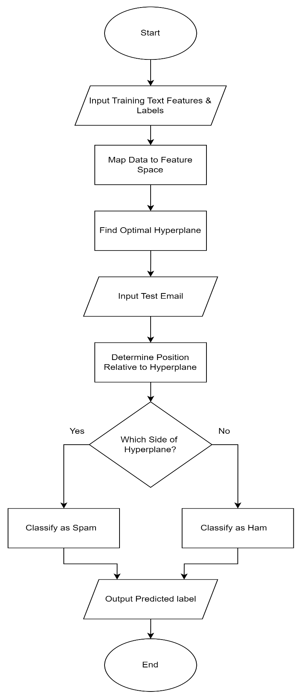
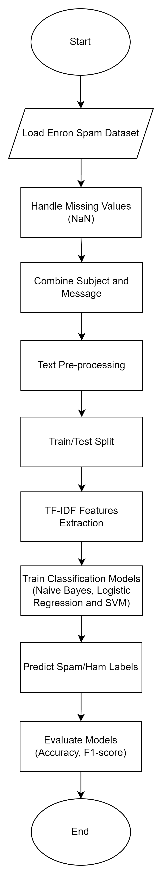
Flowchart
Naïve Bayes Logistic Regression Support Vector Machine System
(SVM)

Slide 11
Conclusion
An AI based spam email detection system was developed using Naïve Bayes, Logistic Regression and SVM with TF-IDF feature extraction.
The models achieved high accuracy and F1-scores, with SVM performing best, indicating effective text classification.
Train-Test evaluation and cross validation showed stable performance with no significant overfitting.
The system can classify user input in real time as spam or ham.
The solution improves email security and user experience with scope for future enhancements using advance models.

Slide 12
Thank You

